Slide 1
Assignment1
Min Wei,Li

Slide 2
Data 1

Slide 3
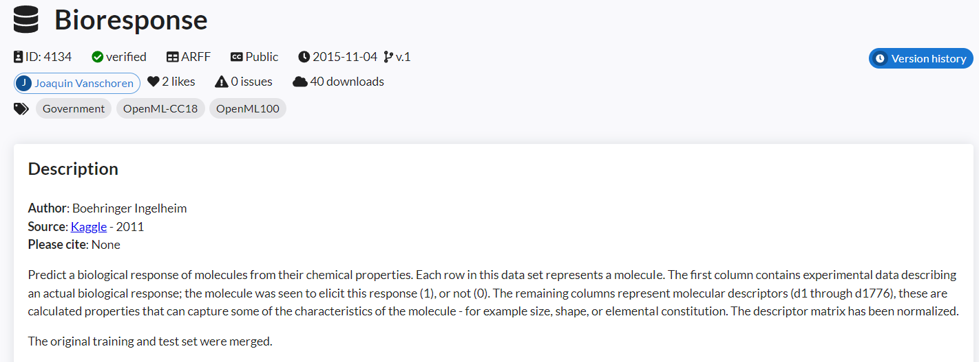
Data 1
data_id = 4134 (name = Bioresponse)
Data mission is to predict a biological response of molecules from their chemical properties.
Each row in this data set represents a molecule.
the molecule was seen to elicit this response (1), or not (0).
https://www.openml.org/search?type=data&sort=qualities.NumberOfNumericFeatures&status=any&qualities.NumberOfClasses=%3D_2&qualities.NumberOfInstances=between_1000_10000&id=4134

Slide 4
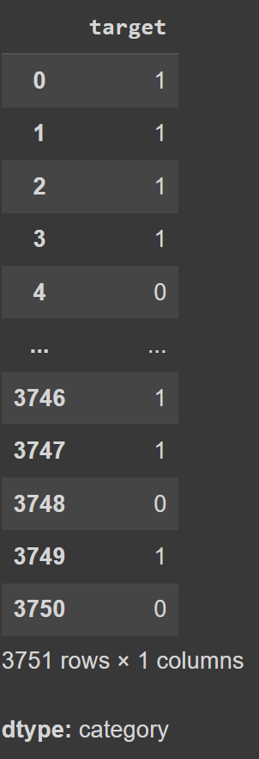
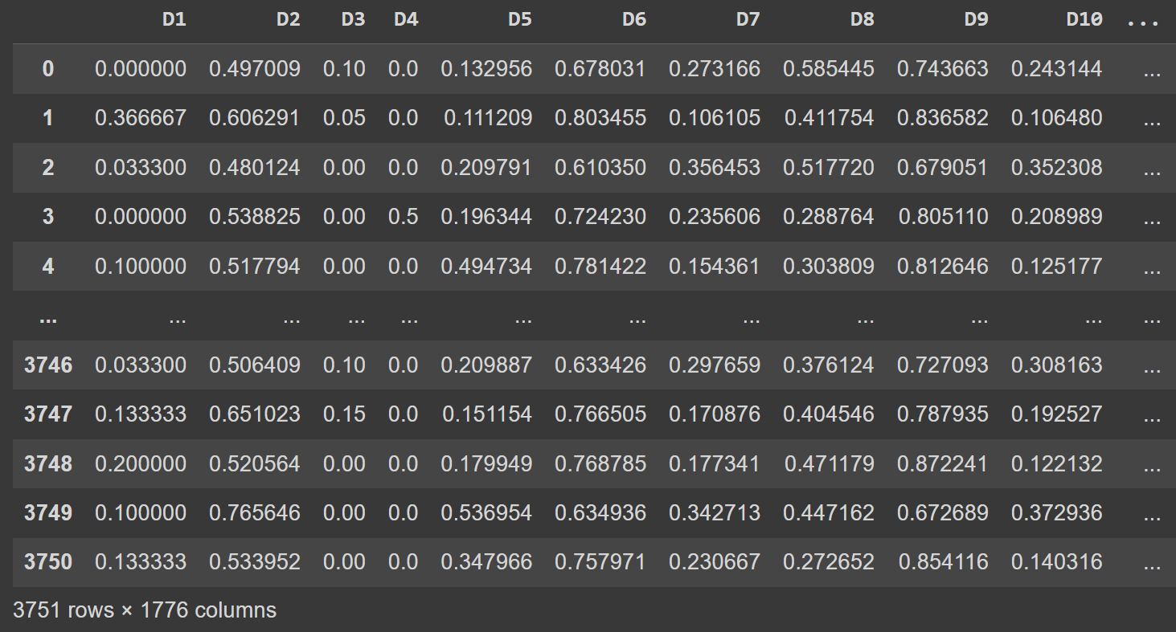
Feature of Data 1
Target of Data 1

Slide 5
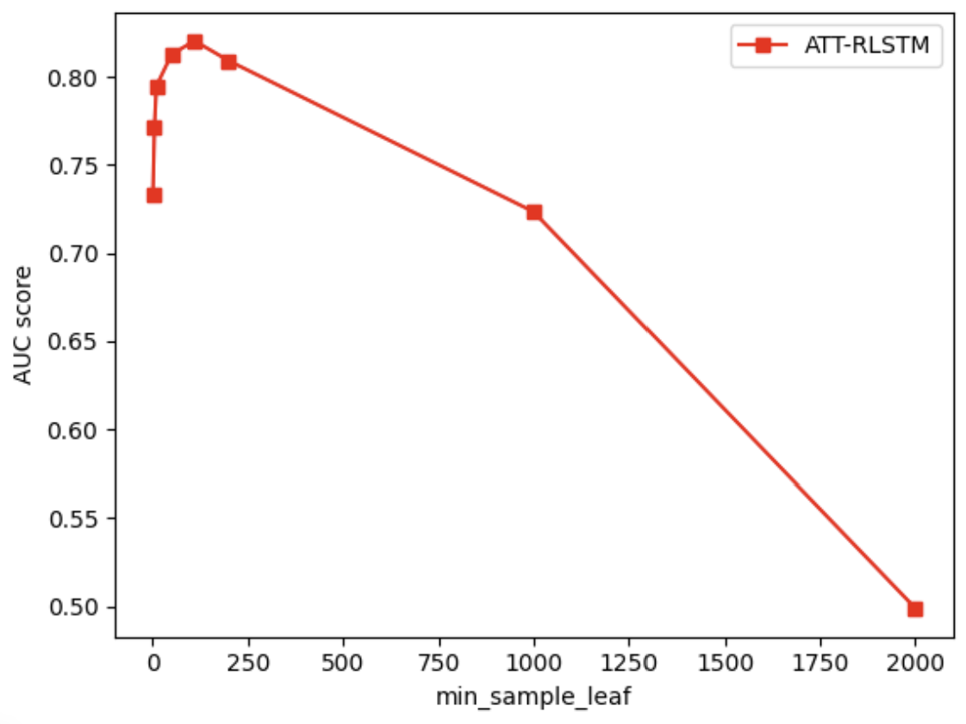
AUC score for each parameters
min_samples_leaf = 1
AUC score = 0.73
min_samples_leaf = 5
AUC score = 0.77
min_samples_leaf = 10
AUC score = 0.79
min_samples_leaf = 50
AUC score = 0.81
min_samples_leaf = 110 (the best)
AUC score = 0.82
min_samples_leaf = 200
AUC score = 0.81
min_samples_leaf = 1000
AUC score = 0.72
min_samples_leaf = 2000
AUC score = 0.5
Overfitting
Underfitting

Slide 6
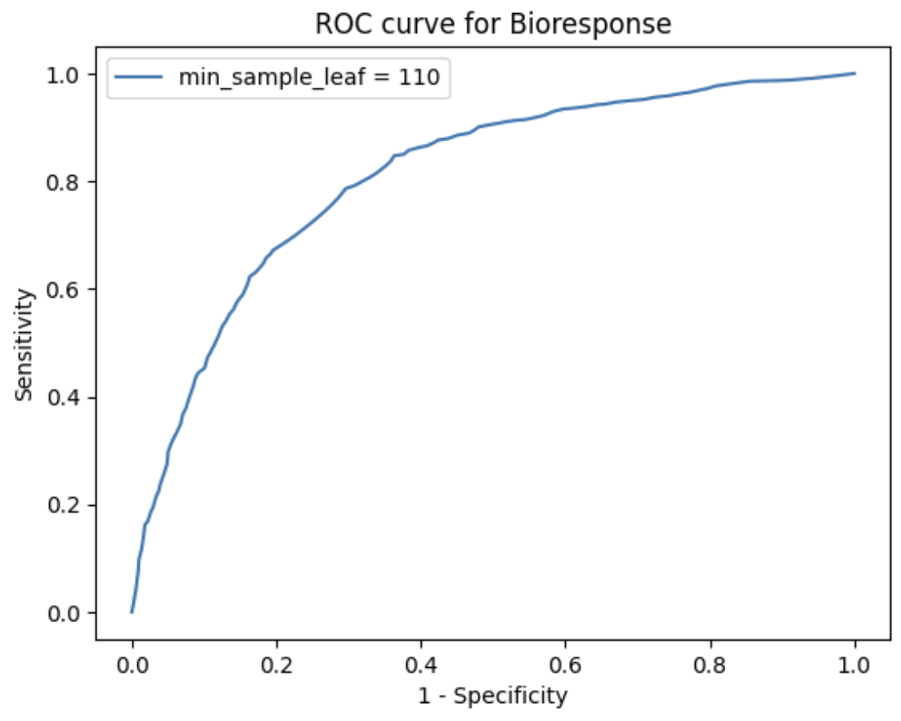
ROC curve for Bioresponse

Slide 7
Discussion of the results for Data 1
1. In this experiment, we first use a for loop to identify the regions where overfitting and underfitting occur. When the number of min_samples_leaf is too small, the decision tree tends to overfit due to the excessive depth of the tree. On the other hand, when the number of min_samples_leaf is too large, the decision tree becomes too shallow, leading to underfitting.
2. The large number of features in Data 1 results in longer training times. Additionally, the high number of features causes the Decision Tree's AUC score to peak around 0.82, indicating that this dataset may be more suitable for training with more complex models.

Slide 8
Data 2

Slide 9
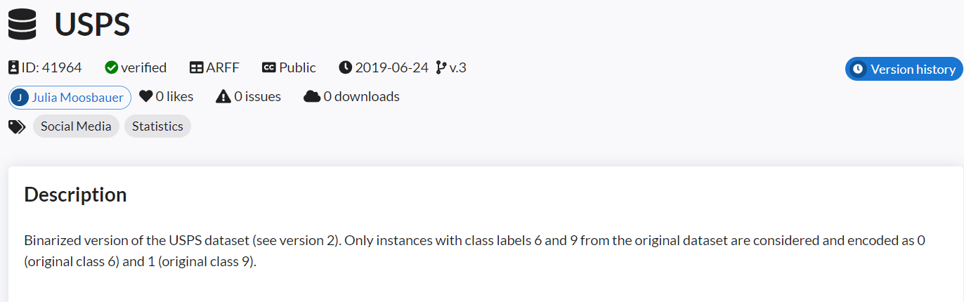
Data 2
data_id = 41964 (name = USPS)
Data mission is to classify 6 and 9 from datasets.
encoded as 0 (original class 6) and 1 (original class 9).
https://www.openml.org/search?type=data&sort=qualities.NumberOfNumericFeatures&status=any&qualities.NumberOfClasses=%3D_2&qualities.NumberOfInstances=between_1000_10000&id=41964

Slide 10
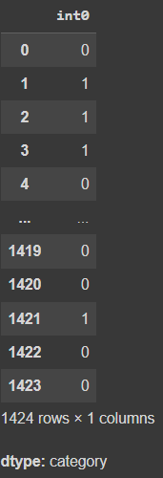
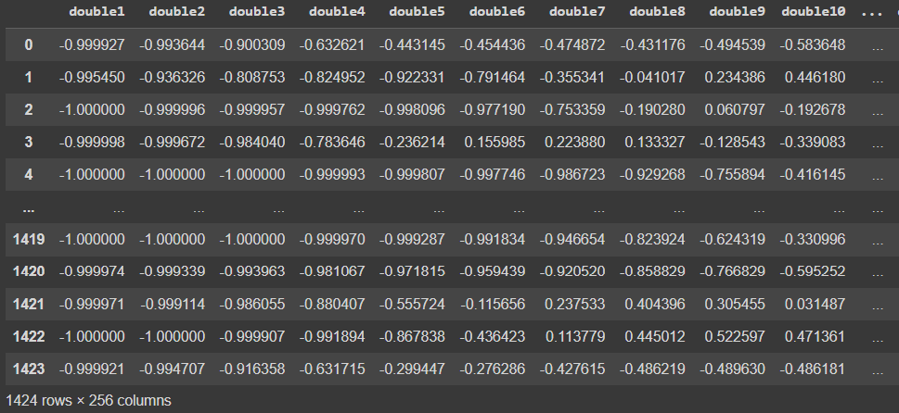
Feature of Data 2
Target of Data 2

Slide 11
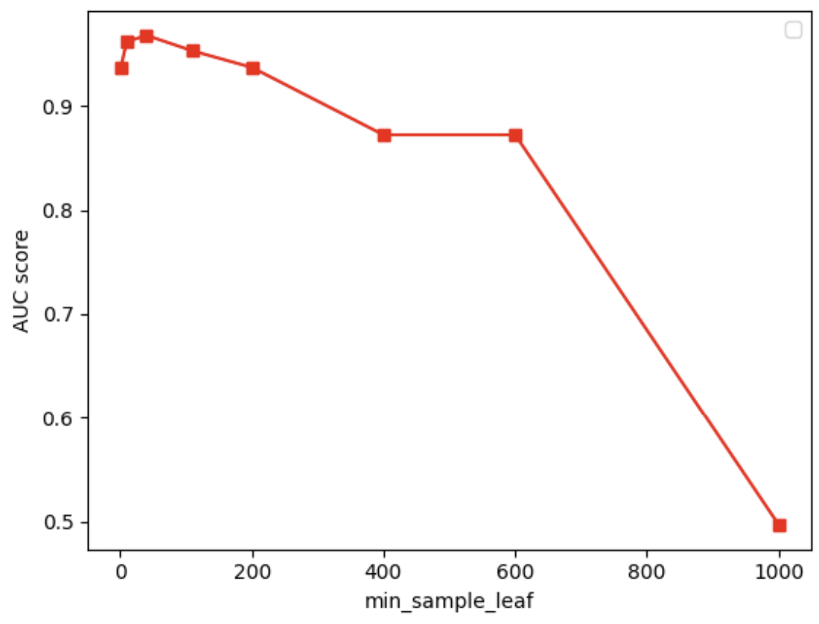
AUC score for each parameters
min_samples_leaf = 1
AUC score = 0.93
min_samples_leaf = 10
AUC score = 0.96
min_samples_leaf = 40 (the best)
AUC score = 0.97
min_samples_leaf = 110
AUC score = 0.95
min_samples_leaf = 200
AUC score = 0.94
min_samples_leaf = 400
AUC score = 0.87
min_samples_leaf = 600
AUC score = 0.87
min_samples_leaf = 1000
AUC score = 0.5
Overfitting
Underfitting

Slide 12
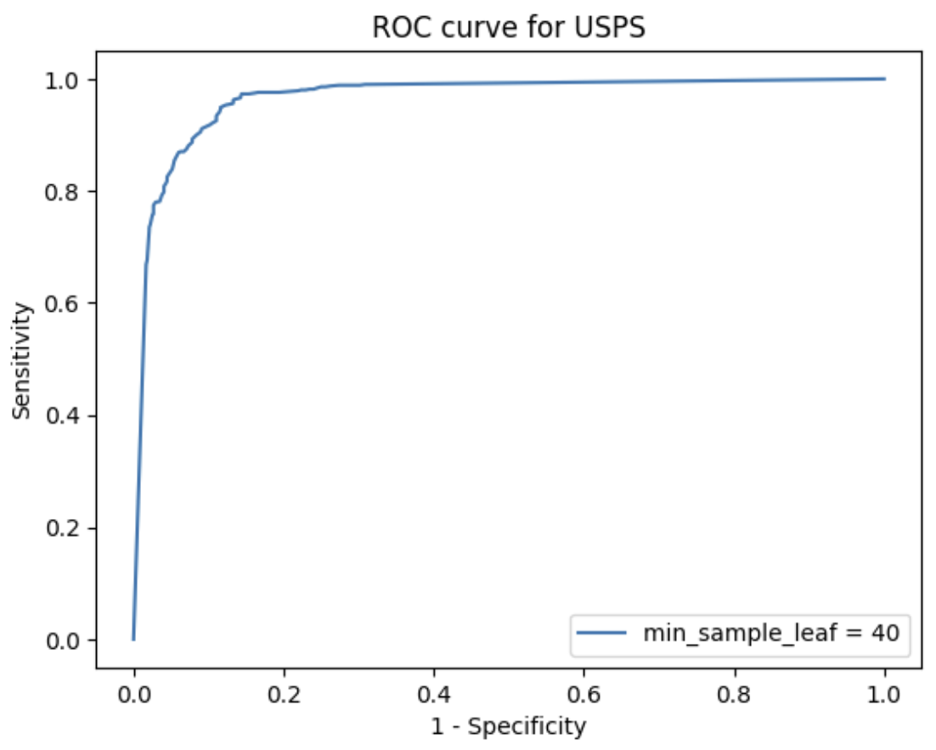
ROC curve for Data 2

Slide 13
Discussion of the results for Data 2
In the case of Data 2, since there are fewer features, the model's training time is relatively shorter. Additionally, it can be observed that when the min_samples_leaf value is below a certain threshold, the decision tree's AUC scores are high, typically above 0.9. This indicates that the decision tree model is well-suited for handling datasets with fewer features, although care must be taken to avoid overfitting.

